Slide 1

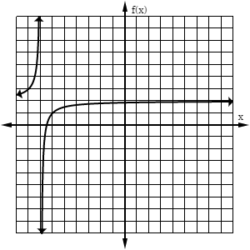
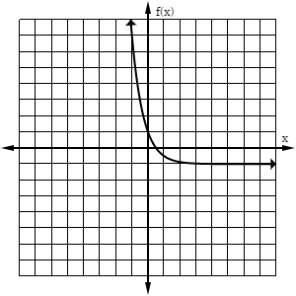
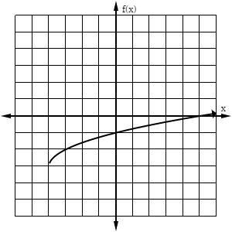
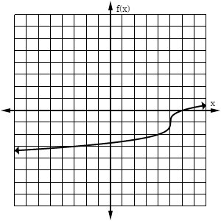
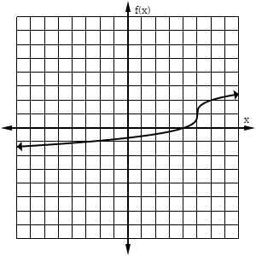
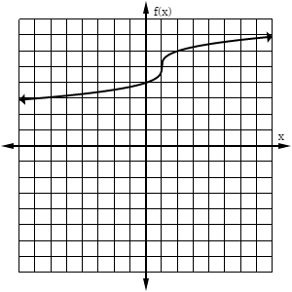
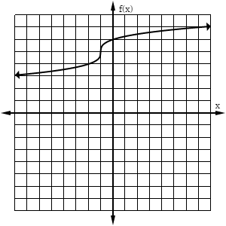
3. Which equation best represents this graph?
1. Which equation best represents this graph?
A. C. B. D.
4. Which equation best represents this graph?
A. C. B. D.
2. Which graph represents the function ?
A. C. B. D.
A.
B.
5. The graph of a function is shown below. Which family could this function belong to?
f(x)
C.
D.
x
A. Exponential C. Square Root B. Logarithmic D. Rational

Slide 2

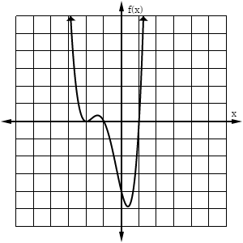
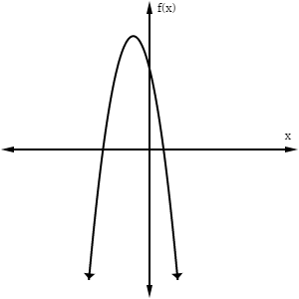
6. The graph of a 4th-degree polynomial is shown. How many real zeros does this function have?
10. Which is a zero of ?
A. C. B. D.
A. 1 B. 2 C. 3 D. 4
11. The graph of has –
A. An x-intercept at (-2, 0). B. An x-intercept at (-1, 0). C. A y-intercept at (0, -2). D. A y-intercept at (0, -1).
7. Which of the following functions has a range of all real numbers?
A. B. C. D.
12. The graph of is increasing through which interval?
A. C. B. D.
8. The graph of a function is shown below. Which function belongs to this same family?
13. Marlena sketched the graph of the function , then reflected it across the x-axis. As x approaches negative infinity, which of the following describes the end behavior of the reflected function?
A. B. C. D.
A. C. B. D.
9. What is the vertical asymptote of the graph of the equation below?
14. Which function has domain of all real numbers greater than or equal to 7?
A. B. C. D.
A. C. B. D.

